Slide 1

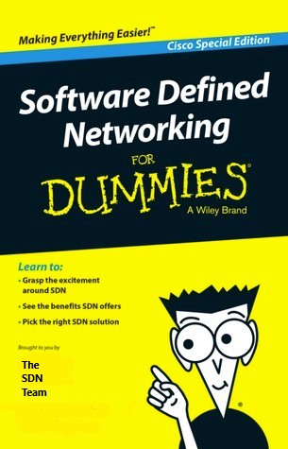
Perimeter Network Fabric
NWG PNF Network Overview
15/06/2020
Information Classification − Internal

Slide 2
Purpose of Slide Deck
Provide high level overview of PNF to promote understanding and enable easier consumption of network services
Overview of New Software Defined Network (SDN)
  Delivered as part of the Data Centre Network Risk Remediation (DCNRR) project
  Went live early June 2018
  Based on the Cisco Application Centric Infrastructure (ACI) and VMWare NSX products
  Deployed in Melville Gate and Macmerry Data Centres
  Built to LSP-400 resilience model
  Separates control plane (APIC controller) from data plane (network switches)
  Redesigned in Q2/Q3 2019 to migrate to a single network (PNF) with revised connectivity model
Connectivity Capabilities
  Bare-metal servers/services
  Integrated with virtual compute deployments (NSX/VxBlock/VxRail)
  Traditional routing/network devices (routers, switches, firewalls, load-balancers)
Purpose of Deck
  High-Level overview of PNF network
  Provide project and technical communities an insight in to how the new PNF network works and how it potentially affects the deployment of their projects/services on to it

Slide 3
Acronyms/Terms
SDN (Software Defined Network) : A generic collective name for the new networks deployed in both the Melville Gate and Macmerry DCs.
PNF (Perimeter Network Fabric) : The second cross-DC physical network deployed which will contain all of the secure perimeter networks and services going forward. This includes (but is not limited to) Internet access, Cloud connectivity, 3rd party connectivity, etc. The PNF also connects to HOLI (via new physical firewalls) and to the SDC (via new PNF firewalls).
DIA (Direct Internet Access) : Non-scalable, tactical solution, to allow latency sensitive internet traffic to egress direct bypassing proxy services
VRF (Virtual Routing and Forwarding) : A feature which enables a network device to create logically separate instances of routing tables. Most network devices can support the creation of multiple VRFs allowing for multiple logical networks to be created on the same physical hardware whilst retaining logical separacy.
VDOM (Virtual Domain) : A Fortinet firewall feature allowing us to provision multiple logical firewall instances on the same physical hardware.
ACI (Application Centric Infrastructure) : Cisco ACI is the product name for the SDN network.
APIC (Application Policy Infrastructure Controller) : The server/s used to make changes to the SDN network. There are up to 6 x APICs per physical network (6 x INF and 6 x PNF). Changes can be made either via the APIC GUI, the APIC REST API or the APIC command line (CLI).
Spine, Leaf & FEX (Fabric Extenders) : The new SDN networks are built in a spine and leaf topology with 100Gb links between each leaf and spine switch. Note that there are no leaf-to-leaf connections. FEX provide top-of-rack connectivity for up-to 1Gb copper connections.
SAL (Service Access Leaf) & BSL (Border Services Leaf) : 1/10/40Gig fibre switches providing different functions (SALs typically connect end-hosts/servers to the network whereas BSLs connect external services such as firewalls, F5s, connections to external networks, etc.).
IPN (Inter-Pod Network) : The IPN network provides the inter-DC connectivity for each fabric enabling it to extend fabrics across both DCs. There is a separate IPN for the INF and PNF networks. The INF network in MG is one POD and the INF in MM is another POD (and similar for PNF).
EPG (End-Point Group) : EPGs are used to define common services in to a single object. EPGs are DC specific.
Contract : A contract is a security policy used to provide connectivity between different EPGs.
L3Out : An L3Out is an object in the SDN network which defines an external layer-3 service (firewalls or F5s for example).
VZAny : A special object allowing all objects/EPGs within a VRF to be able to consume them without explicitly defining individual contracts.

Slide 4
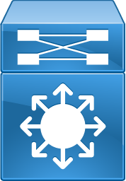

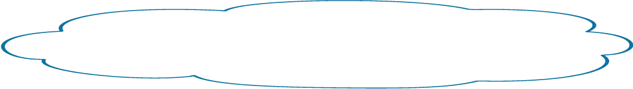

Existing Data Centre – The Old Solution
Melville Gate
Macmerry
MG-ACCESS-SW2
Trunk Link
MM-ACCESS-SW2
Trunk Link
Trunk Link
.10
.11
Trunk Link
PRIMARY
STANDBY
MG-ACCESS-SW1
Server VLAN 10.10.10.0/24
(Virtual IP Gateway = 10.10.10.1)
MM-ACCESS-SW1
10.10.10.0/24
Advertised in to
Core
10.10.10.0/24
Advertised in to
Core
MG-CORE-SW1
MM-CORE-SW1
Edinburgh DC
Zone 7 / HOLI / Corenet

Slide 5
Existing Data Centre – The Problem
Single Fault Domain
Stretched Layer 2
Single DC
Legacy Technology (EOL/EOS)
Combined Mgmnt/Control/ Data Plane

Slide 6
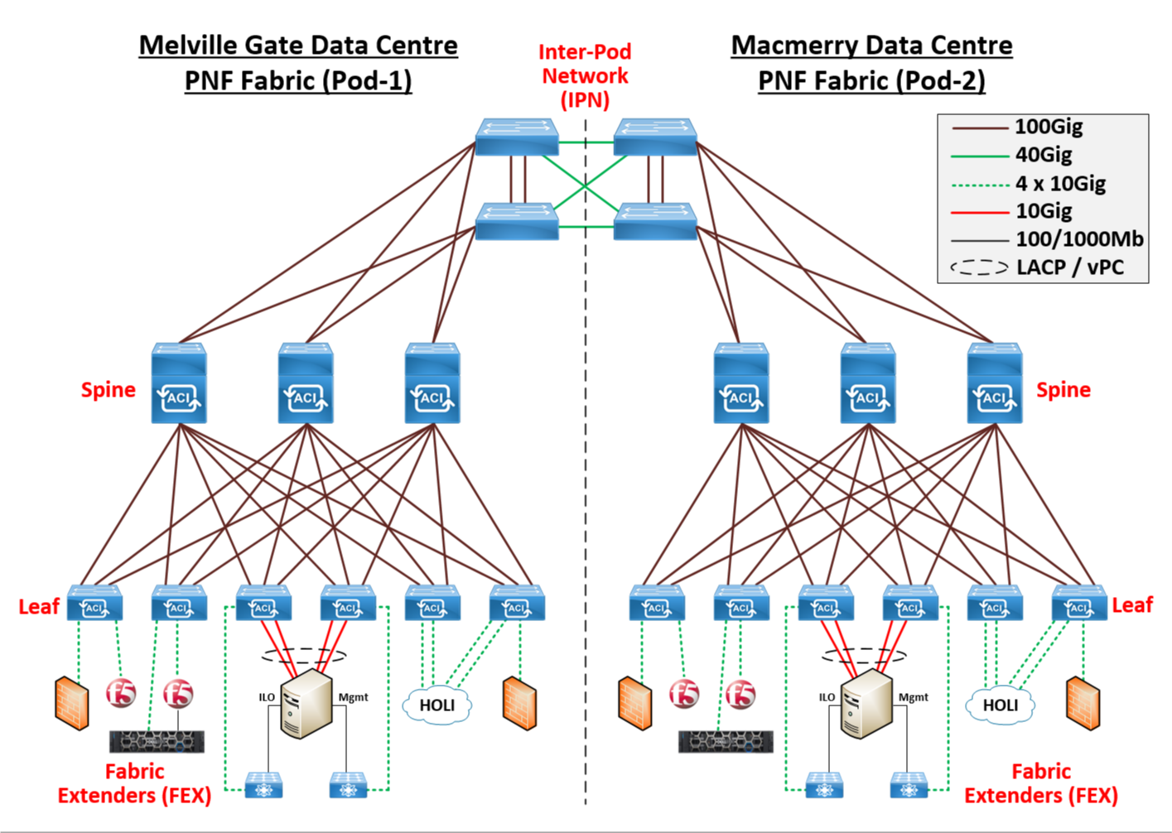
PNF Physical

Slide 7
Security Controls
PNF is a zero-trust network by default and all traffic will be dropped
Physical Fortigate Firewalls
  Dedicated physical & logical firewalls for PNF DMZ/Mgmt
  Dedicated physical & logical firewalls for PNF Internet Services
  Dedicated physical & logical firewalls for PNF Cloud & 3rd party connectivity
  Tied-down firewall policies
NSX Distributed Firewalls
  Part of the core capability from VMWare provided in the IaaS/PaaS environments
  Industry strength distributed and virtual firewalls
  Tied-down firewall policies
  Provide Microsegmentation
ACI Contracts
  Contracts define connectivity allowed between different logical groupings of hosts
  Logical groupings of hosts are referred to as Endpoint Groups (EPG)
  Contracts will bolster the security controls already present with the firewall components

Slide 8
PNF Zero Trust Explained
Reason for Zero Trust
Prior to the PNF, the traditional Corenet/HOLI/Zone 7 network environments (excluding any perimeter environments such as LSP, SSI, etc.) were fully open and anything could connect to anything else within the same Zone 7 environment globally. The potential risks around this type of open connectivity became apparent during the Wannacry 2018 outbreak which heavily impacted the NHS. This highlighted the risks of open networks and more importantly, having very limited options when needing to restrict or disable connectivity to protect core services.
The new PNF network has been built with a "zero-trust" concept. Zero-trust basically means that all connectivity either within the PNF or to/from virtual or physical components in the PNF must be explicitly allowed.
By default, nothing deployed in to the PNF can communicate with anything else
There are a few exceptions for IaaS hosts that by default have access to core shared services when deployed (such as NTP, DNS, Active Directory, NetBackup). But these default rules are minimal.
So what does this mean for me?
One of the key requirements for anyone deploying anything within the PNF is understanding what their system needs to communicate with (the interfaces) and how their system does this (protocols, ports, flows, which directions, etc.). This requirement for designs is not new. Official design documents used for governance have always had sections where application designers are required to include details of the interfaces to their systems along with the protocols and ports used for each flow. The adoption of the PNF zero-trust model now emphasises the fact that application or systems designers must understand how their applications or systems work. These flow details are imperative in turning them in to firewall policies, whether they be physical firewall or distributed firewall policies.

Slide 9
PNF Zero Trust Explained (cont.)
Why are there different types of firewalls in the PNF?
Within the PNF network are physical and distributed (virtual) firewalls. Each type of firewall performs a specific role in security the PNF network to meet the required IT Security policies.
Both the physical and distributed firewalls have been classified as being able to perform a Primary and Secondary security control point by IT Security.
The IT Security policy states;
- Traffic between hosts that are within the same Security Classification zones must go through at least one primary security control point
- Traffic between hosts that are in different Security Classification zones must go through a primary and a secondary security control point
*Realisation patterns and Security Control Patterns may require additional security, such as WAF, depending on traffic type & flow
Physical Firewalls
In the PNF, we use a number of physical Fortinet Fortigate firewalls running a number of virtual firewall instances (VDOMs) to provide policy control points. The majority of these VDOMs provide a North-South security control point between different security zones. And some provide firewall protection for deployments of physical/bare-metal hosts.
The physical firewalls in the PNF are classed as a primary security control point and therefore are key in providing restrictive access to PNF hosted services.
At the present time, the PNF has 11 VDOMs per Data Centre providing security control points between a number of different environments. These include the inner (DMZ) perimeter to HOLI/Zone 7, management, Direct Internet Access, Internet, 3rd party and multiple Cloud environments. The physical firewalls you will need to consider will depend on where you are deploying your new PNF hosted service and where you need to connect to/from it.

Slide 10
Southbound Firewall Rules (PNF > Core)
In a recent development, to ease implementation and speed up deployments within the PNF, the southbound firewall flows are now open using “open managed rules”. These have been put in place as per the agreement and sign-off between RBS Security and SDN team. This implementation adds open rules on physical firewalls, with more granular control on NSX Distributed firewall (dFW)
This comprises of the following:
IaaS to Core (Bidirectional) – Block bad ports & permit all
PaaS to Core (Bidirectional) – Block bad ports & permit all
CaaS to Core (Bidirectional)* – Block bad ports & permit all
IaaS to Physical (Bidirectional) – Block bad ports & permit all
Note* - at the time of writing this email, CaaS rules have been added on the PNF inner firewalls but are currently disabled. This is because we are trying to agree the process, ownership and governance that ECP-CaaS team will need to adhere to from security standpoint and once this is agreed and signed-off - all these rules will be enabled. In the interim, any CaaS requirements will need dedicated rules on physical firewalls.

Slide 11
PNF Technologies
All physical firewalls are classified as PRODUCTION and support the North-South connectivity for the entire PNF.
There are no specific DEV/TEST/NFT firewalls and therefore all deployments and changes must be categorised appropriately.
The same is true for the ACI Fabric (network components) that the PNF is built upon
Distributed Firewalls (dFW)
Within the new PNF Infrastructure as a Service (IaaS) compute environment, every virtual machine (VM) has a distributed firewall embedded in to it. Excluding firewall policies to allow basic access to core shared services, each dFW will require policies specific to the application or service being deployed. The dFWs themselves are capable of operating at layer-7 of the OSI model meaning that for each firewall policy defined, the policy can restrict connectivity to just an application running on a VM. This capability ensure that only the required applications, services or processes running on the VM are allowed to communicate based on the dFW policy.
Load Balancer as a Service (LBaaS)
LBaaS is a service that is also embedded in the NSX environment (IaaS). Requested through a SNow form and created using automation. Whilst it does not have the full functionality of an F5 ADC, if simple load balancing is required, this is the most efficient method. LBaaS is provisioned for Single DC load balancing, cross site load balancing for LBaaS is provided by the use of a GTM
ADC in the PNF (Application Delivery Controllers) F5
These provide traditional load balancing services, where LBaaS is deemed unsuitable. Additionally, they provide WAF and RCP (Routing Control Point) functionality where traffic flow is from a less secure zone to a more secure zone e.g. CoreNet>Z8. In some realisation patterns, the ADC can be substituted with TYK (API Gateway). These solutions are clearly defined in the artefacts. (see link at end of presentation). Cross Data Centre load balancing is provided by GTM ADC component, as per LBaaS.
ACI Contracts and Endpoint Groups
    EPGs define groupings of endpoints that have a common function/service
    All intra-EPG connectivity between hosts is open
    Consumer and provider essentially dictate which side will initiate the connection
    Where true bi-directional connectivity is required, two EPGs will be both a provider and consumer

Slide 12
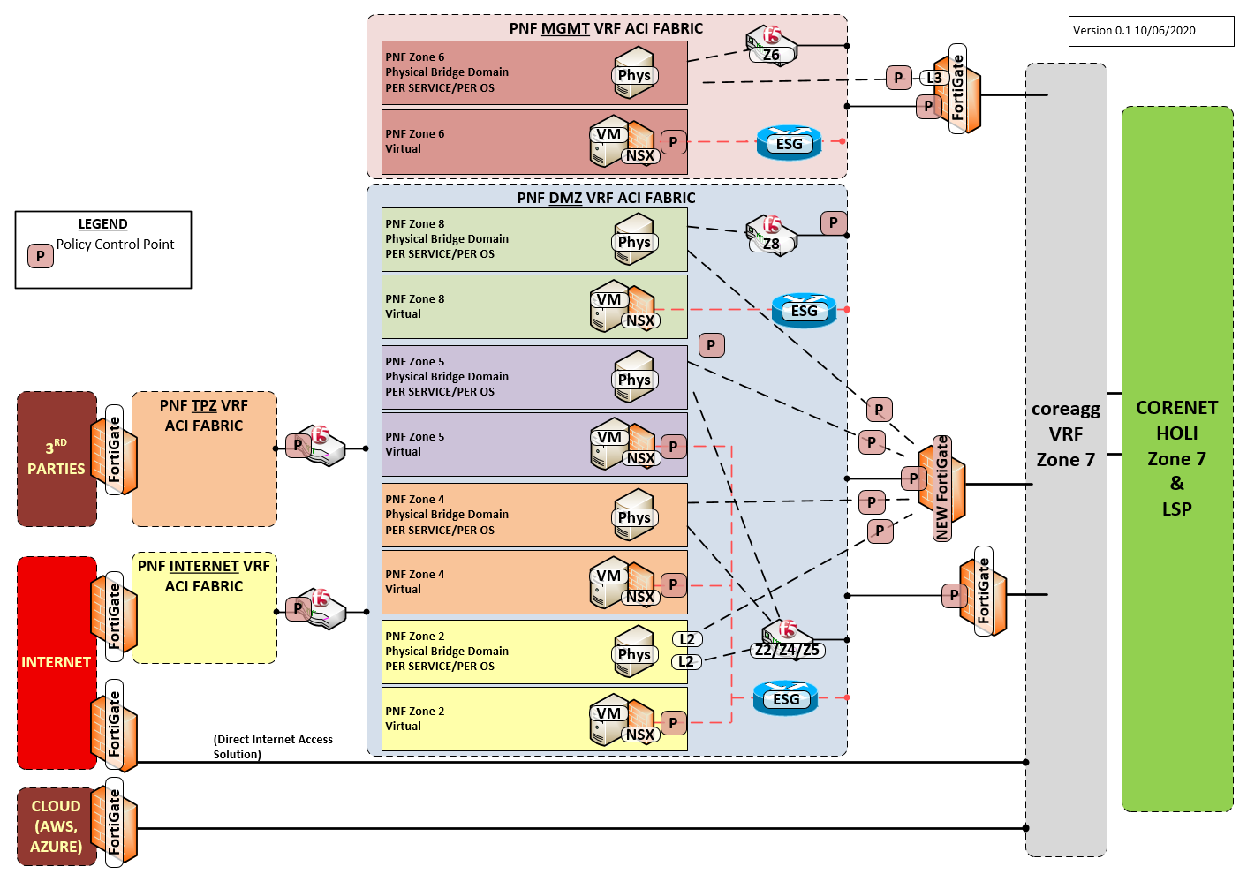
PNF High Level Diagram – Single DC

Slide 13
Deployment Differences to Traditional Networks
Zero-Trust Security Model
    By default, no trusts exists between workloads
    Contracts are required to provide connectivity between EPGs
    Understanding IP connectivity profiles for each service is a key requirement (the SDN team are happy to assist projects in identifying what these are)
VLAN/Subnet Segmentation Concept
    There is no longer a concept of using VLANs to contain common services (such as large shared DC server subnets or small LSP service-specific subnets)
    The PNF does not allow for spanned layer-2 VLANs to be deployed. In the traditional DC environments (DCLI and LSP), the two Edinburgh Data Centres could be looked at as one logical DC due to the cross-DC spanlan capabilities. This capability has been dropped in the PNF due to it being designed to a 400 Resilience Model and both DCs are now considered as two totally separate environments with their own IP address space per DC
    This restriction does not mean that a component in one DC cannot communicate with another. But it does mean that a host in one DC cannot be placed on the same layer-2 VLAN/layer-3 subnet as a host in the other DC. Cross-DC connectivity is possible within the PNF either via routing across the PNF fabric interconnects or via the core (with the appropriate dFW or pFW controls in place).

Slide 14
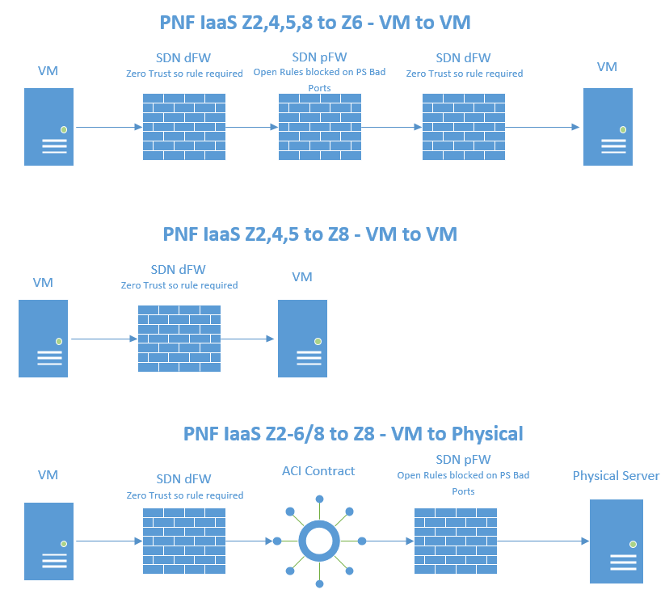
IaaS Example Flows
    Example flows (excluding WAF/RCP)

Slide 15
Questions

Slide 16
About DC Networks
Network Team providing DevOps support for the NWG Data Centres in Melville Gate, Macmerry & Stone
Multi-faceted platform comprised of SDN (ACI, NSX, Public Cloud, Security), Traditional Data Centre Networks and TDA/Platform Assurance
Useful Links
  SDN Intranet Page - https://intranet.rbsres01.net/Technology/DCNetworking/Pages/default.aspx
  SDN Confluence Page - https://confluence.dts.fm.rbsgrp.net/display/SPT/SDN+Product+Team+Home

Slide 17
DC Organisation
Steven Henderson
Data Centre Lead
Nipun Mehta
Security Lead
Grant Ingram
NSX Tower Lead
Mark Cole
Public Cloud Lead
Colin Marquis
ACI Tower Lead
Robbie Gray
Service Manager
Barry Howieson
TDA / Platform Assurance
Matt Owen
Traditional DC
Ian Mackinnon
NSX Product Owner
Brian Feeney
PC Engineer
Mihai Burghelea
ACI Product Owner
Ken Boyd
+447557283782
Mark Mackay
SDN Engineer
Kostas Chiotakis
SDN Engineer
Gareth Morrison
Martin Jarvis
+447909 686774
Pierre Assamoua
SDN Engineer
Girija Gaunker
SDN Engineer
Abokor Ahmed
(VMWARE ELA)
Pradeep Kataria
SDN Engineer
Leon Cozzi
(VMWARE ELA)
Kamil Miekus
SDN Engineer
Chris Brown
SDN Engineer
Rob Taplin
(Cisco AS)
Michal Lemiezewski
SDN Engineer
Than Pham
SDN Engineer
Kris Wiselka
SDN Engineer
Paul Burt
SDN Engineer
Scott Boylan
(IAM NSX SME)

Slide 18
Further Reading & References
Realisation Patterns - https://confluence.dts.fm.rbsgrp.net/display/SOLP/Solution+Patterns+Library
Designing for the PNF - https://confluence.dts.fm.rbsgrp.net/display/SOLP/Designing+for+PNF
Security Control Patterns - https://confluence.dts.fm.rbsgrp.net/x/djp6Iw
Security Inter-Zonal Matrix - https://intranet.rbsres01.net/Security/Idliketonowhowto/Pages/default.aspx (Navigate to “Firewalls”)

